Slide 1

turtle编程题
Ablock创客教育
Notes:
更多模板请关注：https://haosc.taobao.com

Slide 2

turtle库编程题
知识体系 | 单选 | 判断 | 编程
编程环境（10分） | 6 | 4 | 0
编程基础（26） | 10 | 12 | 4
turtle库（24分） | 14 | 4 | 6
数学运算（30分） | 18 | 0 | 12
计算思维（10分） | 2 | 0 | 8
分值 | 50分 | 20分 | 30分
题数 | 25题 | 10题 | 2题

Slide 3
turtle库编程题
绘制一个半径为100的圆，边框为黄色，填充为红色
import turtle
turtle.pensize(10)
turtle.color("yellow","red")
turtle.begin_fill()
turtle.circle(100)
turtle.end_fill()
turtle.done()

Slide 4
turtle库编程题
绘制一个数字8
import turtle
turtle.pensize(10)
turtle.circle(100)
turtle.circle(-100)
turtle.done()

Slide 5
turtle库编程题
绘制一个正方形，边框为红色，填充为绿色
import turtle
turtle.pensize(10)
turtle.color("red","green")
turtle.seth(45)
turtle.begin_fill()
turtle.circle(100, 360,4)
turtle.end_fill()
turtle.done()

Slide 6
turtle库编程题
绘制一段曲线
import turtle
turtle.pensize(10)
turtle.color("red")
for i in range(4):
turtle.circle(100, 40)
turtle.circle(-100, 40)
turtle.done()

Slide 7
turtle库编程题
绘制一个边长为100的正九边形
import turtle
turtle.pensize(10)
turtle.color("red")
for i in range(9):
turtle.fd(100)
turtle.left(40)
turtle.done()

Slide 8
turtle库编程题
绘制一个边长为100的三角形，边框红色，填充黄色
import turtle
turtle.pensize(10)
turtle.color("red","yellow")
turtle.begin_fill()
for i in range(3):
turtle.fd(100)
turtle.left(120)
turtle.end_fill()
turtle.done()

Slide 9
turtle库编程题
绘制一个边长为100的三角形，边框红色，填充黄色
import turtle
turtle.pensize(10)
turtle.color("red","yellow")
turtle.begin_fill()
for i in range(3):
turtle.fd(100)
turtle.left(120)
turtle.end_fill()
turtle.done()

Slide 10
turtle库编程题
绘制一个五角星
import turtle
turtle.pensize(10)
turtle.color("yellow","yellow")
turtle.begin_fill()
for i in range(5):
turtle.fd(100)
turtle.right(144)
turtle.end_fill()
turtle.done()

Slide 11
turtle库编程题
绘制一个直径为10的蓝色圆点
import turtle
turtle.color("blue")
turtle.dot(10)
turtle.done()

Slide 12
绘制一个田字形方框，分别填充红、黄、蓝、绿
turtle库编程题
turtle.seth(180)
turtle.color("blue","blue")
turtle.begin_fill()
for i in range(4):
turtle.fd(100)
turtle.right(90)
turtle.end_fill()
turtle.seth(-90)
turtle.color("green","green")
turtle.begin_fill()
for i in range(4):
turtle.fd(100)
turtle.right(90)
turtle.end_fill()
turtle.done()
import turtle
turtle.color("red","red")
turtle.begin_fill()
for i in range(4):
turtle.fd(100)
turtle.right(90)
turtle.end_fill()
turtle.seth(90)
turtle.color("yellow","yellow")
turtle.begin_fill()
for i in range(4):
turtle.fd(100)
turtle.right(90)
turtle.end_fill()

Slide 13

turtle库编程题
绘制一个四叶草，如下图所示
import turtle
turtle.color("green","green")
turtle.begin_fill()
for i in range(4):
turtle.circle(100)
turtle.right(90)
turtle.end_fill()
turtle.done()

Slide 14

turtle库编程题
绘制一颗星星，如下图所示
import turtle
turtle.color("yellow","yellow")
turtle.begin_fill()
turtle.circle(100,90)
turtle.circle(-100,-90)
turtle.circle(100,90)
turtle.circle(-100,-90)
turtle.end_fill()
turtle.done()

Slide 15
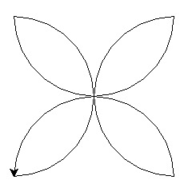
turtle库编程题
绘制以下图案
import turtle
turtle.seth(0)
turtle.circle(100,180)
turtle.seth(-90)
turtle.circle(100,180)
turtle.seth(-180)
turtle.circle(100,180)
turtle.seth(90)
turtle.circle(100,180)
turtle.done()

Slide 16
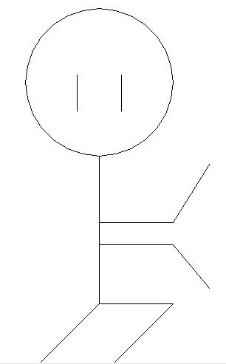
turtle库编程题
绘制以下图案
turtle.pu()
turtle.goto(0,-90)
turtle.pd()
turtle.goto(100,-90)
turtle.goto(150,-10)
turtle.pu()
turtle.goto(-30,110)
turtle.pd()
turtle.goto(-30,60)
turtle.pu()
turtle.goto(30,110)
turtle.pd()
turtle.goto(30,60)
turtle.hideturtle()
turtle.done()
import turtle
turtle.circle(100)
turtle.goto(0,-200)
turtle.goto(-100,-300)
turtle.pu()
turtle.goto(0,-200)
turtle.pd()
turtle.goto(100,-200)
turtle.goto(0,-300)
turtle.pu()
turtle.goto(0,-120)
turtle.pd()
turtle.goto(100,-120)
turtle.goto(150,-180)

Slide 17
THANK YOU
教师：赵老师

